Slide 1

Tune Clairvoyant
A Music Recommendation App
CAPSTONE TERM I
AIDI Fall 2021 Section B
2021-12-14

Slide 2
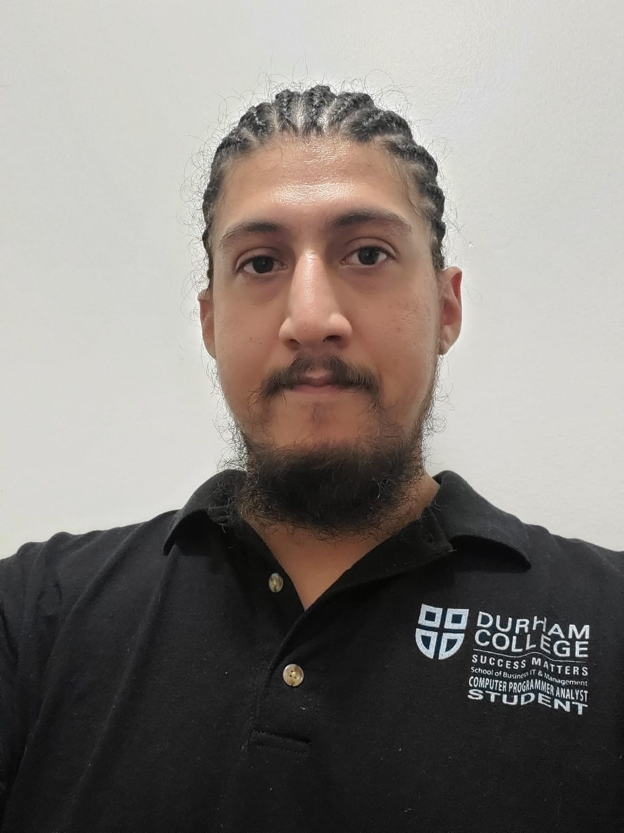
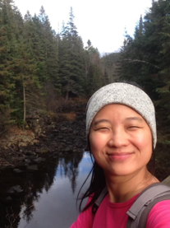
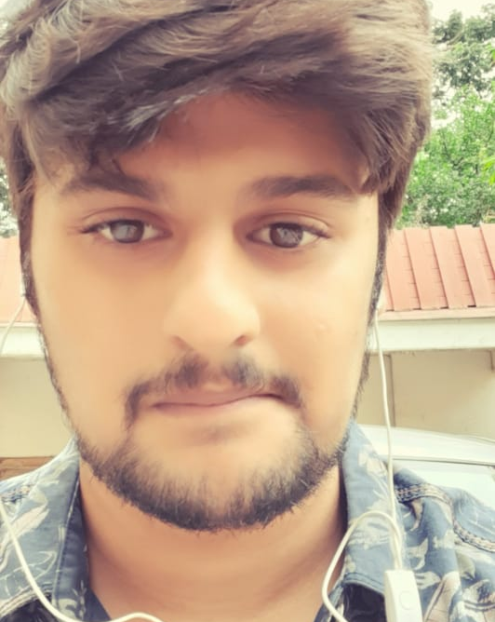

Meet Our Team
Joseph Mendez
Ariel Chen
Shrijit Pendse
Esra Ersoy
I am a CPA graduate from Durham College, with honours.
With experience with Riot Radio at the Oshawa campus, I look forward to completing this capstone project!
From Taiwan
Entry level programmer
Like memes, hike and swim
I have a Bachelor’s degree in Electronics and Telecommunications and a PGDM in Data Analytics.
My bachelor's degree is in Mathematical Engineering. And I worked as business analyst in software development projects in Turkey.

Slide 3







Project Definition
TOPIC
Build an application that is powered by AI - A real solution of music recommendation system. Our objective is using AI agents and algorithms to provide the end user with music suggestions they will enjoy. Based on interaction (song search and mood) and users’ profile.
TECHNOLOGY
Spotify songs dataset (Data source)
Python (AI model programming)
Github (Version control)
Flask (Front-end)
Spotify Widget

Slide 4
Tune Clairvoyant
FUNCTIONALITY
☑ A simple Login System to collect user profile (not password field type of login logout)
☑ Based on User Profile (gender, artist name, genre of music) to train our AI agent and recommend songs ☑ A Search Box for users to find the songs name and recommend songs
☑ A section to pick Mood and Feeling (ex: Energetic, Calm, Happy, Sad, and Live) based on which songs will get recommended

Slide 5
Tune Clairvoyant
CHALLENGES
POTENTIAL IMPROVEMENTS
Choosing the correct front-end and cloud-based technology
Implementing a dataset to store user information like favorite artists and genres.
Getting the favorite to input the selected song into the User table
Auto complete functionality on search box for songs
LIKE or DISLIKE icons next to the suggested tracks in order to feed our data for ML model improvement purposes.
Sentiment analysis on users’ comment and take it to recommendation system
Algorithm to include time played vs length of song
Integrate database management system: ex: MySQL, or PostgreSQL

Slide 6
Tune Clairvoyant
DEMO

